Slide 1
Junit Training – Day 6
Qwest Bangalore

Slide 2


The Testing Problems
Should write
Do
programmers
few
Why?
I am so busy
It is difficult

Slide 3
The Testing Problems
Programmers need such kind of tool:
“Writing a few lines of code, then a test that should run, or even better, to write a test that won't run, then write the code that will make it run.”
JUnit is that kind of tool!

Slide 4
JUnit Tutorial
The testing problems
The framework of JUnit
A case study
JUnit tool
Practices

Slide 5
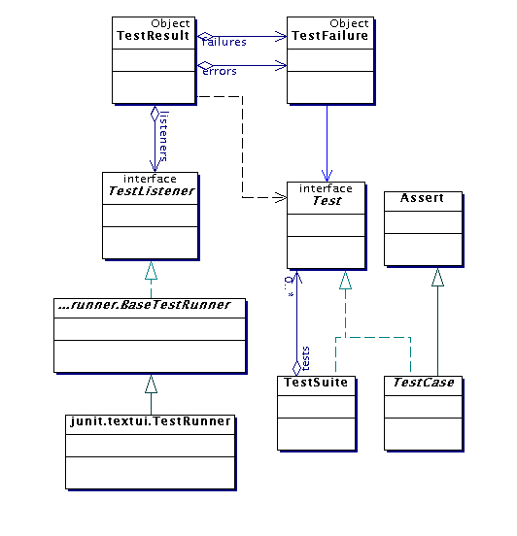
The Framework of JUnit

Slide 6
JUnit Tutorial
The testing problems
The framework of JUnit
A case study
JUnit tool
Practices

Slide 7
A Case Study
class Money {
private int fAmount;
private String fCurrency;
public Money(int amount, String currency) {
fAmount= amount;
fCurrency= currency; }
public int amount() { return fAmount; }
public String currency() { return fCurrency; }
public Money add(Money m) {
return new Money(amount()+m.amount(), currency()); }
}

Slide 8
How to Write A TestCase
public class MoneyTest extends TestCase {
//…
public void testSimpleAdd() {
Money m12CHF= new Money(12, "CHF"); // (1)
Money m14CHF= new Money(14, "CHF");
Money expected= new Money(26, "CHF");
Money result= m12CHF.add(m14CHF); // (2)
Assert.assertTrue(expected.equals(result)); // (3)
}
}
(1) Creates the objects we will interact with during the test. This testing context is commonly referred to as a test's fixture. All we need for the testSimpleAdd test are some Money objects.
(2) Exercises the objects in the fixture.
(3) Verifies the result

Slide 9
Assert
assertEquals(expected, actual)
assertEquals(message, expected, actual)
assertEquals(expected, actual, delta)
assertEquals(message, expected, actual, delta)
assertFalse(condition)
assertFalse(message, condition)
Assert(Not)Null(object)
Assert(Not)Null(message, object)
Assert(Not)Same(expected, actual)
Assert(Not)Same(message, expected, actual)
assertTrue(condition)
assertTrue(message, condition)

Slide 10
Structure
setUp()
Storing the fixture's objects in instance variables of your TestCase subclass and initialize them by overriding the setUp method
tearDown()
Releasing the fixture’s
run()
Defining how to run an individual test case.
Defining how to run a test suite.
testCase()

Slide 11
Structure of Writing A Test
public class MoneyTest extends TestCase {
private Money f12CHF;
private Money f14CHF;
protected void setUp() {
f12CHF= new Money(12, "CHF");
f14CHF= new Money(14, "CHF"); }
public void testSimpleAdd() {
Money expected= new Money(26, "CHF");
Money result= f12CHF.add(f14CHF);
Assert.assertTrue(expected.equals(result)); }
TestCase test= new MoneyTest("simple add") {
public void runTest() { testSimpleAdd(); }
}
}

Slide 12

Design Test Cases
The real world scenarios
The number boundaries
Smaller than 0 such as –1, -2, …, -100, …
0
Bigger than 0 such as 1, 2, …, 100…

Slide 13
The Feedback to Code
class Money {
private int fAmount;
private String fCurrency;
public Money(int amount, String currency) {
fAmount= amount;
fCurrency= currency; }
public int amount() { return fAmount; }
public String currency() { return fCurrency; }
public Money add(Money m) {
if (m.amount()<=0) throw exception;
return new Money(amount()+m.amount(), currency());
}
}

Slide 14
Test Case and Test Suite
TestCase test= new MoneyTest("simple add")
{
public void runTest() {
testSimpleAdd();
}
}
public static Test suite() {
TestSuite suite= new TestSuite();
suite.addTest(new MoneyTest("testEquals"));
suite.addTest(new MoneyTest("testSimpleAdd"));
return suite;
}

Slide 15
Static and Dynamic Run
JUnit supports two ways of running single tests:
static
dynamic
TestCase test= new MoneyTest("simple add")
{
public void runTest() {
testSimpleAdd();
}
}
TestCase test= new MoneyTest("testSimpleAdd");
Since JUnit 2.0 there is an even simpler dynamic way. You only pass the class with the tests to a TestSuite and it extracts the test methods automatically.
public static Test suite() { return new TestSuite(MoneyTest.class); }

Slide 16
JUnit Tutorial
The testing problems
The framework of JUnit
A case study
JUnit tool
Practices

Slide 17
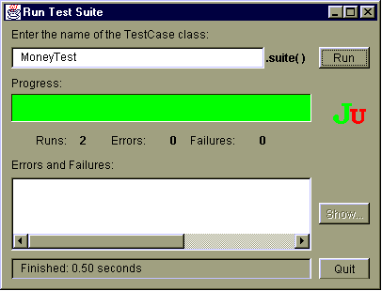
JUnit

Slide 18
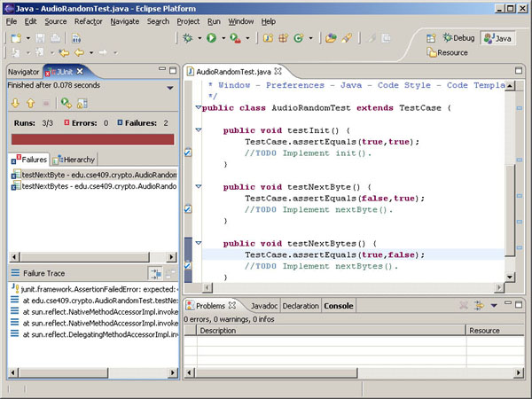
JUnit for Eclipse

Slide 19
Start to Use it
1. Download the latest version of JUnit from http://download.sourceforge.net/junit/
2. Installation
unzip the junit.zip file
add junit.jar to the CLASSPATH. For example: set classpath=%classpath%;INSTALL_DIR\junit3\junit.jar
3. Testing
Test the installation by using either the batch or the graphical TestRunner tool to run the tests that come with this release. All the tests should pass OK.
for the batch TestRunner type: java junit.textui.TestRunner junit.samples.AllTests
for the graphical TestRunner type: java junit.awtui.TestRunner junit.samples.AllTests
for the Swing based graphical TestRunner type: java junit.swingui.TestRunner junit.samples.AllTests
Notice: The tests are not contained in the junit.jar but in the installation directory directly. Therefore make sure that the installation directory is on the class path
Important: Don't install the junit.jar into the extension directory of your JDK installation.
If you do so the test class on the files system will not be found. JUnit plug-in for Eclipse

